Slide 1
Normal Forms: Summary (1)
Relationships between different NFs.
1NF
2NF
3NF
BCNF

Slide 2
Normalization (1)
A relation schema is in good quality if it is in BCNF.
If a relation schema is not in BCNF, then decompose it into a set of schemas such that
every new schema is in BCNF;
it is a lossless-join decomposition;
it is a dependency-preserving decomposition.

Slide 3
Normalization (2)
Problem: There is no guarantee that such an ideal decomposition exists.
can guarantee: lossless-join decomposition into BCNF.
can't guarantee: dependency-preserving decomposition into BCNF.

Slide 4
Normalization (3)
If R is not even in 3NF, decompose it into a set of schemas such that
every new schema is in 3NF;
it is a lossless-join decomposition;
it is a dependency-preserving decomposition.
Such a decomposition can always be found!

Slide 5
Normalization to BCNF (1)
Algorithm LLJD-BCNF
Input: A relation schema R, a set of FDs in R.
Output: A lossless-join decomposition D such that each new schema in D is in BCNF.

Slide 6
Normalization to BCNF (2)
D := {R};
while ∃ R_{i} ∈ D that is not in BCNF do {
find an FD X Y such that
(1) X Y makes R_{i} not in BCNF, and
(2) XY ⊆ R_{i};
replace R_{i} by (R_{i} – Y) and XY in D;
}

Slide 7
Normalization to BCNF (3)
Theorem 5: Algorithm LLJD-BCNF is correct.
Every schema in D is in BCNF because the algorithm will not stop if there is a schema in D that is not in BCNF.
D is a lossless-join decomposition because in each iteration R_{i} is decomposed into 2 smaller schemas (R_{i} – Y) and XY and they satisfy the condition:
(R_{i} – Y) ∩ XY = X (XY – (R_{i} – Y)) = Y.

Slide 8
Normalization to BCNF (4)
Example: Prod_Manu(Prod_no, Prod_name, Price, Manu_id, Manu_name, Address),
F = {Mi Mn A, P# Pn Mi}.
Note that Price is not involved in any functional dependency.
Candidate keys: P# Pr
Initialization: D = {P# Pn Pr Mi Mn A}

Slide 9
Normalization to BCNF (5)
1st iteration: R_{i} = {P# Pn Pr Mi Mn A} is not in BCNF because Mi Mn A is not a trivial FD and Mi is not a superkey.
Replace R_{i} by Mi Mn A and P# Pn Pr Mi.
Hence: D = {Mi Mn A, P# Pn Pr Mi}.
Mi Mn A is in BCNF because in Mi Mn A, Mi is a candidate key.
How about P# Pn Pr Mi? Is it in BCNF?

Slide 10
Normalization to BCNF (6)
2nd iteration: R_{i} = P# Pn Pr Mi is not in BCNF because P# Pn Mi is not a trivial FD and P# is not a superkey in P# Pn Pr Mi.
Replace P# Pn Pr Mi by P# Pn Mi and P# Pr.
Hence, D = {Mi Mn A, P# Pn Mi, P# Pr}.
P# Pn Mi is in BCNF because in P# Pn Mi, P# is a candidate key.
P# Pr is in BCNF (see theorem on next page).
Final result: D = {Mi Mn A, P# Pn Mi, P# Pr}.
Question: Is D dependency-preserving?
Answer: Yes.

Slide 11
Normalization to BCNF (7)
Theorem 6: Any relation schema with exactly two attributes is in BCNF.
The proof is not difficult.
Note: The LLJD-BCNF algorithm may produce different decompositions depending on the order in which FDs are considered. Not all decompositions make sense.
Example: Suppose for the earlier example, we apply P# Pn Mi first. The final decomposition would be D = {P# Pn Mi, P# Mn A, P# Pr}. This decomposition separates Mi and Mn A in different schemas.

Slide 12
Minimal Cover (1)
Definition: Let F and G be two sets of FDs in R. F is a cover of G if every FD in G can be derived from the FDs in F.
If F is a cover of G and G is a cover of F, then F and G are equivalent (F ≡ G).

Slide 13
Minimal Cover (2)
Example: Consider F = {B CD, AD E, B A} and G = {B CDE, B ABC, AD E}. Show that F is a cover of G.
(1) AD E in G can be derived from
AD E in F.
(2) From B CD, B A, B B and the union rule: we have B ABCD;
From B ABCD and decomposition rule:
B ABC B ABC in G can be derived from FDs in F.

Slide 14
Minimal Cover (3)
(3) From B ABCD and decomposition
rule: B AD;
From B AD, AD E and
transitivity rule: B E;
From B ABCD, B E and union
rule: B ABCDE;
From B ABCDE and decomposition
rule: B CDE.
Since every FD in G can be derived from FDs in F, F is a cover of G.

Slide 15
Minimal Cover (4)
Definition: Let F be a set of FDs. Fmin is a minimal cover of F if
Fmin is a cover of F.
Every FD in Fmin has a single attribute on the right.
No FD in Fmin is redundant. (X Y∈F is redundant if F – {X Y} ≡ F).
For any X Y ∈ Fmin, no attribute in X is extraneous (A ∈ X is extraneous if (X – {A}) Y can replace X Y).

Slide 16
Minimal Cover (5)
Example: Given F = {A BC, B C,
A B, AB C}, find Fmin.
F ≡ { A B, A C, B C, A B,
AB C } （右边只留一个
≡ { A B, B C, AB C } (消除
≡ { A B, B C } = Fmin
AB决定C变为A决定C
AB多余，A->B,B->C,因此
AB->C

Slide 17
Minimal Cover (6)
Example: Let F = {A AC, B ABC,
D ABC}. Find Fmin.
F ≡ {A A, A C, B A, B B,
B C, D A, D B, D C}
≡ {A C, B A, B C, D A,
D B, D C}
≡ {A C, B A, D B} = Fmin
（D决定B，B决定C，消除决定C

Slide 18
Normalization to 3NF (1)
Algorithm LLJD-DPD-3NF
Input: A relation schema R, a set of FDs F in R.
Output: A lossless-join and dependency-preserving decomposition D such that each schema in D is in 3NF.

Slide 19
Normalization to 3NF (2)
**
(1) Find all candidate keys.
(2) Compute Fmin.
(3) Let X A_{i}, i=1,...,m, be all FDs in Fmin that have the same left hand side X. Create a relation schema X∪ A₁ ∪ . . . ∪ A_{m} in D if it is not a subschema of an existing relation schema.
(4) If none of the relation schemas contain a candidate key of R, use a candidate key to form another relation schema.
确保至少有一个关系模式包含候选键

Slide 20
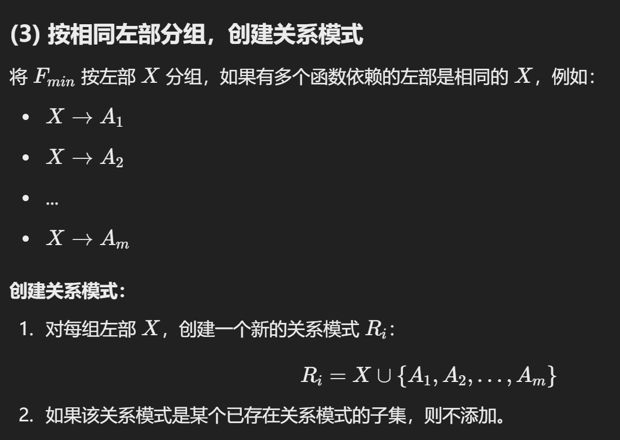
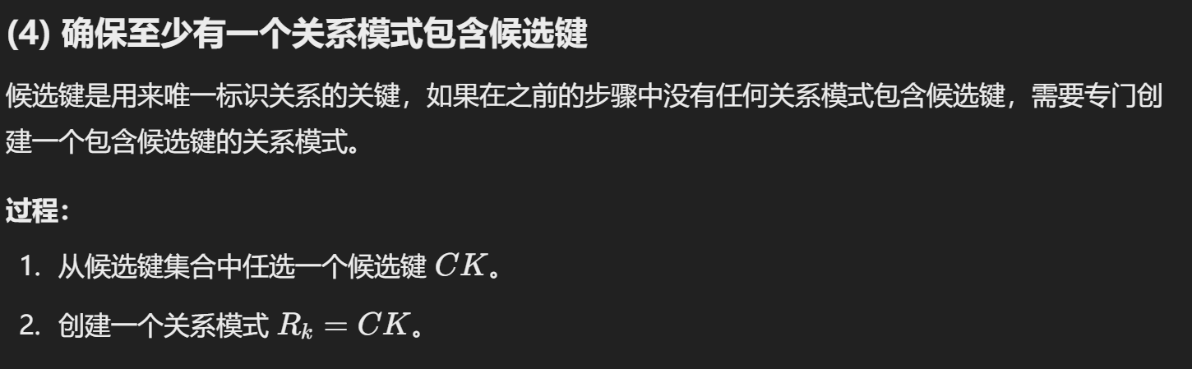

Slide 21
Normalization to 3NF (3)
Example: Given
R(Instructor, Class_no, Classroom, Text),
F = {Class_no Classroom Text}.
Candidate keys: Instructor Class_no.
Fmin = {Class_no Classroom,
Class_no Text}.
D = {Class_no Classroom Text,
Instructor Class_no}

Slide 22
Normalization to 3NF (4)
Example: R = CTHRSG, F = {C T, CS G, HR C, HS R, HT R } (求candidate key
Candidate keys: HS. =>没有入射边
Fmin = F, (用闭包化简
D = {CT, CSG, HRC, HSR, HTR}
HSR contains the candidate key.

Slide 23
Normalization Summary (1)
Given: R – A relation schema
F – A set of FDs in R
Find all candidate keys C of R using F
R, F, C
Is R in BCNF?
yes
done
no

Slide 24
Apply Algorithm LLJD-BCNF to
obtain a decomposition in BCNF
Is the decomposition
dependency-preserving?
yes
done
no
Roll back the decomposition

Slide 25
yes
Is R in 3NF?
done
no
Apply Algorithm LLJD-DPD-3NF
to obtain a decomposition in 3NF
done

